Slide 1
Unit – 4 Deadlock

Slide 2
Deadlock
Permanent blocking of a set of processes that either compete for system resources or communicate with each other
No efficient solution
Involve conflicting needs for resources by two or more processes

Slide 3
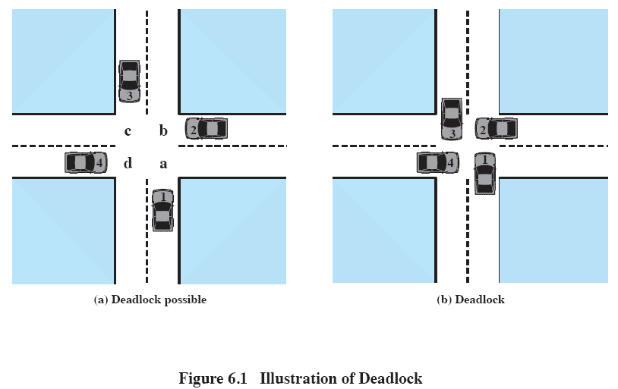
Deadlock

Slide 4
Reusable Resources
Used by only one process at a time and not exhausted by that use.
Processes obtain resources that they later release for reuse by other processes.
Processors, I/O channels, main and secondary memory, devices, and data structures such as files, databases, and semaphores
Deadlock occurs if each process holds one resource and requests the other

Slide 5
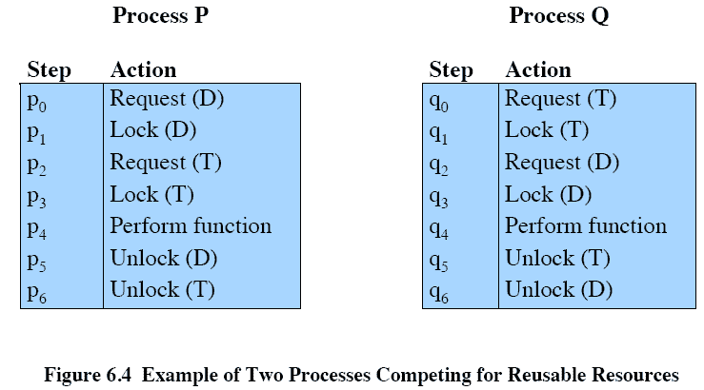
Reusable Resources

Slide 6
Reusable Resources
Space is available for allocation of 200Kbytes, and the following sequence of events occur
Deadlock occurs if both processes progress to their second request
P1
P2
. . .
. . .
Request 80 Kbytes;
Request 70 Kbytes;
. . .
. . .
Request 60 Kbytes;
Request 80 Kbytes;

Slide 7
Consumable Resources
Created (produced) and destroyed (consumed)
Interrupts, signals, messages, and information in I/O buffers
Deadlock may occur if a Receive message is blocking
May take a rare combination of events to cause deadlock

Slide 8
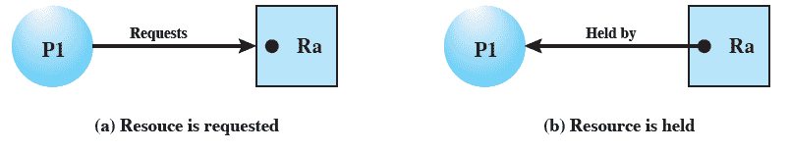
Resource Allocation Graphs
Directed graph that depicts a state of the system of resources and processes

Slide 9
Conditions for Deadlock
Mutual exclusion
Only one process may use a resource at a time
Hold-and-wait
A process may hold allocated resources while awaiting assignment of others
No preemption
No resource can be forcibly removed from a process holding it
Circular wait
A closed chain of processes exists, such that each process holds at least one resource needed by the next process in the chain

Slide 10
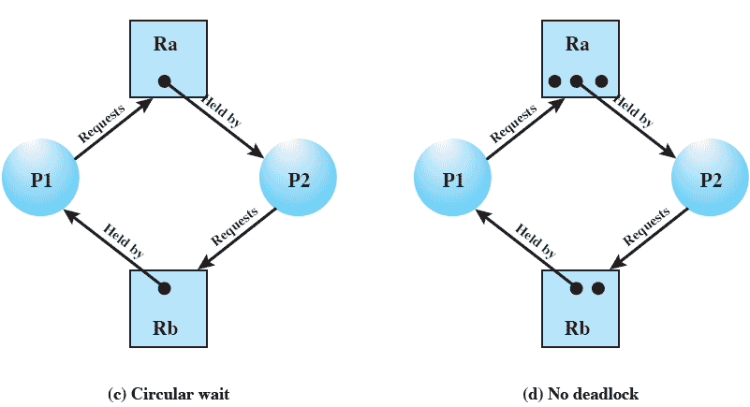
Resource Allocation Graphs

Slide 11
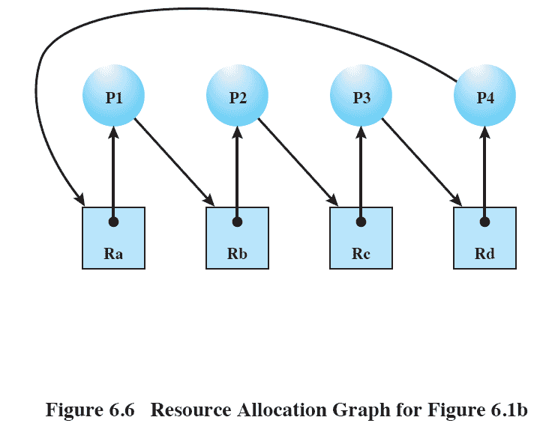
Resource Allocation Graphs

Slide 12
Possibility of Deadlock
Mutual Exclusion
No preemption
Hold and wait

Slide 13
Existence of Deadlock
Mutual Exclusion
No preemption
Hold and wait
Circular wait

Slide 14
Deadlock Prevention
Restrain the ways request can be made
Mutual Exclusion – not required for sharable resources; must hold for non-sharable resources
Hold and Wait – must guarantee that whenever a process requests a resource, it does not hold any other resources
Require process to request and be allocated all its resources before it begins execution, or allow process to request resources only when the process has none
Low resource utilization; starvation possible

Slide 15
Deadlock Prevention (Cont.)
No Preemption –
If a process that is holding some resources requests another resource that cannot be immediately allocated to it, then all resources currently being held are released
Preempted resources are added to the list of resources for which the process is waiting
Process will be restarted only when it can regain its old resources, as well as the new ones that it is requesting
Circular Wait – impose a total ordering of all resource types, and require that each process requests resources in an increasing order of enumeration

Slide 16
Deadlock Avoidance
A decision is made dynamically whether the current resource allocation request will, if granted, potentially lead to a deadlock
Requires knowledge of future process requests

Slide 17
Two Approaches to Deadlock Avoidance
Do not start a process if its demands might lead to deadlock
Do not grant an incremental resource request to a process if this allocation might lead to deadlock

Slide 18
Resource Allocation Denial (Banker’s Algorithm)
Referred to as the banker’s algorithm
State of the system is the current allocation of resources to process
Safe state is where there is at least one sequence that does not result in deadlock
Unsafe state is a state that is not safe

Slide 19
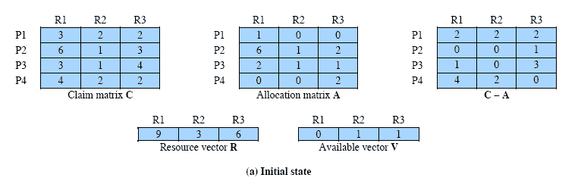
Determination of a Safe State

Slide 20
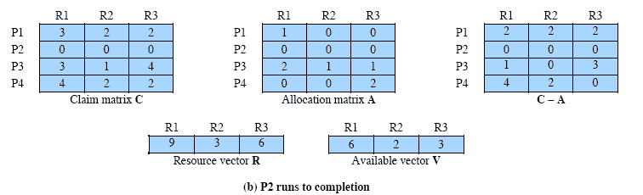
Determination of a Safe State

Slide 21
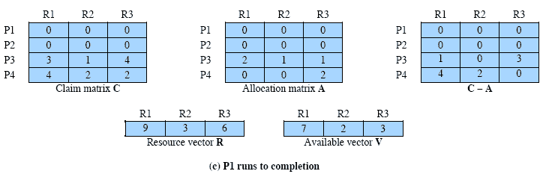
Determination of a Safe State

Slide 22
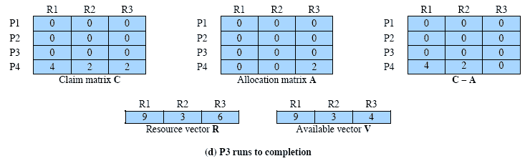
Determination of a Safe State

Slide 23
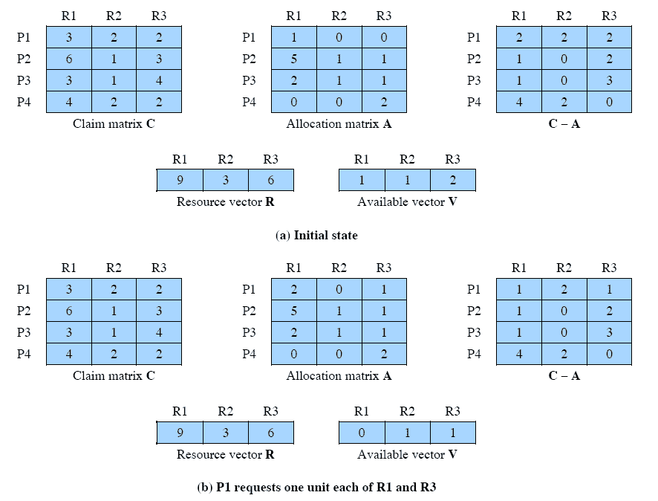
Determination of an Unsafe State

Slide 24
Deadlock Avoidance
Maximum resource requirement must be stated in advance
Processes under consideration must be independent; no synchronization requirements
There must be a fixed number of resources to allocate
No process may exit while holding resources

Slide 25
Deadlock Detection
Allow system to enter deadlock state
Detection algorithm
Recovery scheme

Slide 26
Single Instance of Each Resource Type
Maintain wait-for graph
Nodes are processes
P_{i} → P_{j} if P_{i} is waiting for P_{j}
Periodically invoke an algorithm that searches for a cycle in the graph. If there is a cycle, there exists a deadlock
An algorithm to detect a cycle in a graph requires an order of n² operations, where n is the number of vertices in the graph

Slide 27
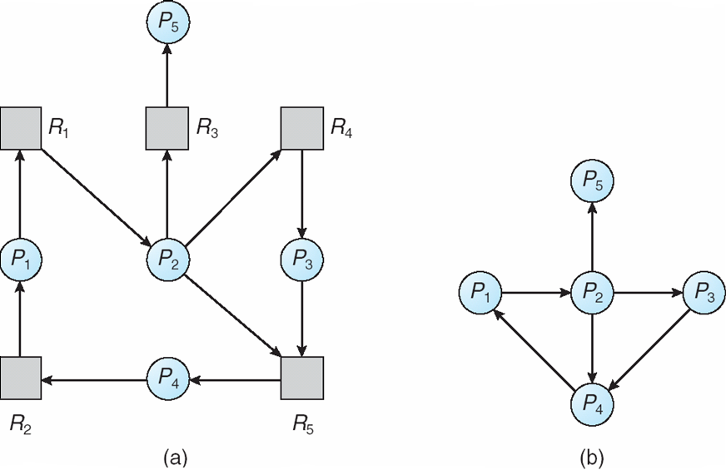
Resource-Allocation Graph and Wait-for Graph
Resource-Allocation Graph
Corresponding wait-for graph

Slide 28
Several Instances of a Resource Type
Available: A vector of length m indicates the number of available resources of each type.
Allocation: An n x m matrix defines the number of resources of each type currently allocated to each process.
Request: An n x m matrix indicates the current request of each process. If Request [i_{j}] = k, then process P_{i} is requesting k more instances of resource type. R_{j}.

Slide 29
Detection Algorithm
1. Let Work and Finish be vectors of length m and n, respectively Initialize:
(a) Work = Available
(b) For i = 1,2, …, n, if Allocation_{i} ≠ 0, then Finish[i] = false; otherwise, Finish[i] = true
2. Find an index i such that both:
(a) Finish[i] == false
Request_{i} ≤ Work
If no such i exists, go to step 4

Slide 30
Detection Algorithm (Cont.)
3. Work = Work + Allocation_{i} Finish[i] = true go to step 2
4. If Finish[i] == false, for some i, 1 ≤ i ≤ n, then the system is in deadlock state. Moreover, if Finish[i] == false, then P_{i} is deadlocked

Slide 31
Example of Detection Algorithm
Five processes P₀ through P₄; three resource types A (7 instances), B (2 instances), and C (6 instances)
Snapshot at time T₀:
Allocation Request Available
A B C A B C A B C
P₀ 0 1 0 0 0 0 0 0 0
P₁ 2 0 0 2 0 2
P₂ 3 0 3 0 0 0
P₃ 2 1 1 1 0 0
P₄ 0 0 2 0 0 2
Sequence <P₀, P₂, P₃, P₁, P₄> will result in Finish[i] = true for all i

Slide 32
Example (Cont.)
P₂ requests an additional instance of type C
Request
A B C
P₀ 0 0 0
P₁ 2 0 1
P₂ 0 0 1
P₃ 1 0 0
P₄ 0 0 2
State of system?
Can reclaim resources held by process P₀, but insufficient resources to fulfill other processes; requests
Deadlock exists, consisting of processes P₁, P₂, P₃, and P₄

Slide 33
Detection-Algorithm Usage
When, and how often, to invoke depends on:
How often a deadlock is likely to occur?
How many processes will need to be rolled back?
one for each disjoint cycle
If detection algorithm is invoked arbitrarily, there may be many cycles in the resource graph and so we would not be able to tell which of the many deadlocked processes “caused” the deadlock

Slide 34
Recovery from Deadlock: Process Termination
Abort all deadlocked processes
Abort one process at a time until the deadlock cycle is eliminated
In which order should we choose to abort?
Priority of the process
How long process has computed, and how much longer to completion
Resources the process has used
Resources process needs to complete
How many processes will need to be terminated
Is process interactive or batch?

Slide 35
Recovery from Deadlock: Resource Preemption
Selecting a victim – minimize cost
Rollback – return to some safe state, restart process for that state
Starvation – same process may always be picked as victim, include number of rollback in cost factor

Slide 36
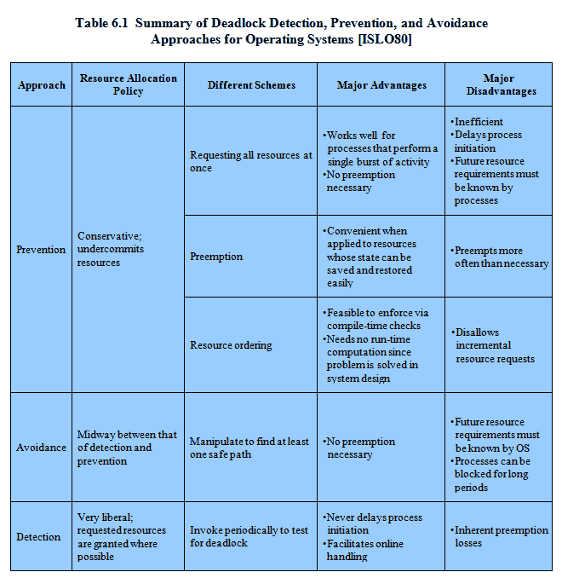
Advantages and Disadvantages

